Slide 1
Multi-View Geometry
Part II
(Ch7 New book.
Ch 10/11 old book)
Guido Gerig
CS 6320 Spring 2012
Credits: M. Shah, UCF CAP5415, lecture 23
http://www.cs.ucf.edu/courses/cap6411/cap5415/, Trevor Darrell, Berkeley, C280, Marc Pollefeys

Slide 2
Multi-View Geometry
Relates
3D World Points
Camera Centers
Camera Orientations

Slide 3
Multi-View Geometry
Relates
3D World Points
Camera Centers
Camera Orientations
Camera Intrinsic Parameters
Image Points

Slide 4
Stereo
scene point
image plane
optical center

Slide 5
Stereo
Basic Principle: Triangulation
  Gives reconstruction as intersection of two rays
  Requires
    calibration
    point correspondence

Slide 6
Stereo Constraints
p
p’
?
Given p in left image, where can the corresponding point p’
in right image be?

Slide 7
Stereo Constraints
M
Image plane
Epipolar Line
Y₁
p
p’
Y₂
X₂
O₁
Z₁
X₁
O₂
Z₂
Focal plane
Epipole

Slide 8
Demo Epipolar Geometry
Java Applet
credit to:
Quang-Tuan Luong
SRI Int.
Sylvain Bougnoux

Slide 9
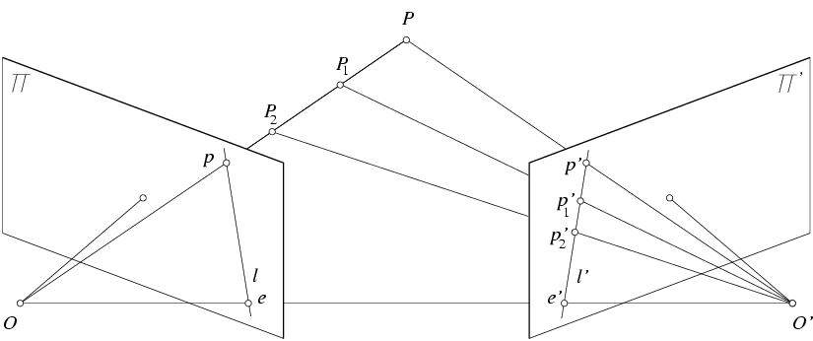
Epipolar constraint
Potential matches for p have to lie on the corresponding
epipolar line l’.
Potential matches for p’ have to lie on the corresponding
epipolar line l.
http://www.ai.sri.com/~luong/research/Meta3DViewer/EpipolarGeo.html
Source: M. Pollefeys
Notes:
9

Slide 10
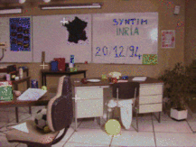
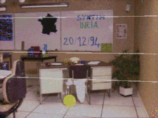
Finding Correspondences
Andrea Fusiello, CVonline
Strong constraints for searching for corresponding points!

Slide 11
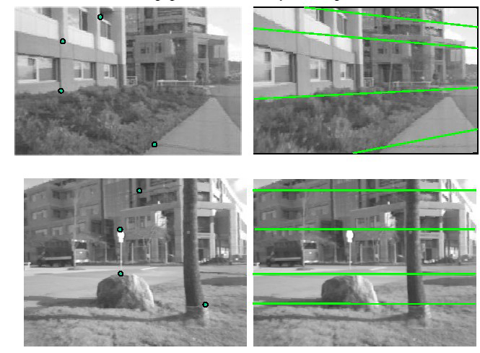
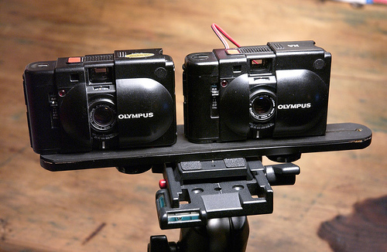
Example
Parallel Cameras: Corresponding points on horizontal lines.

Slide 12
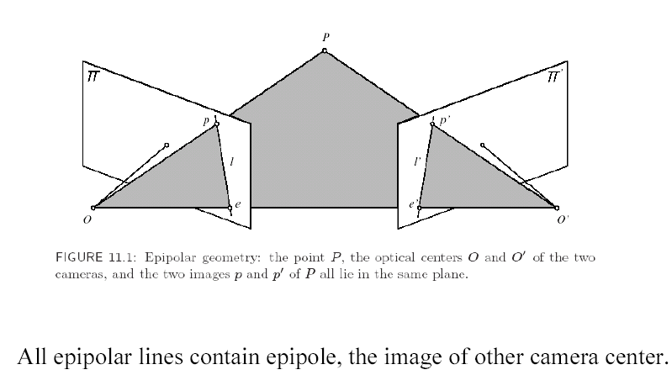
Epipolar Constraint

Slide 13
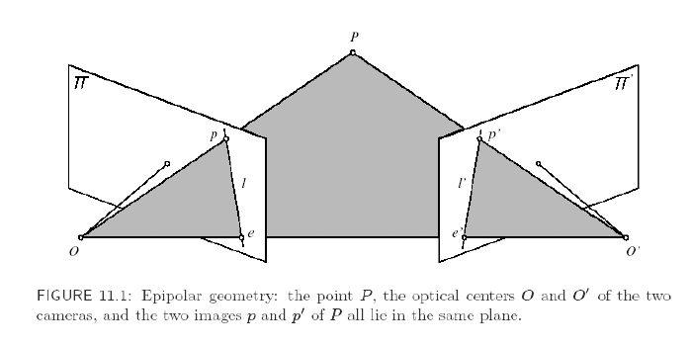
From Geometry to Algebra
P
p
p’
O
O’

Slide 14


From Geometry to Algebra
P
p
p’
O
O’

Slide 15
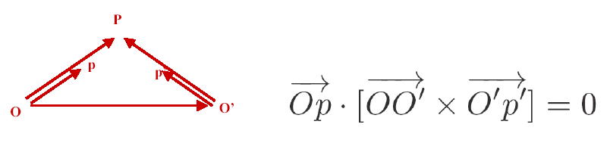
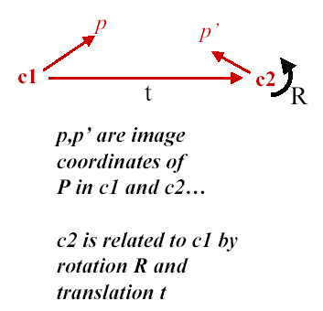
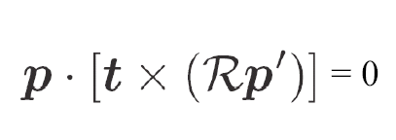
Linear Constraint:
Should be able to express as matrix
multiplication.

Slide 16
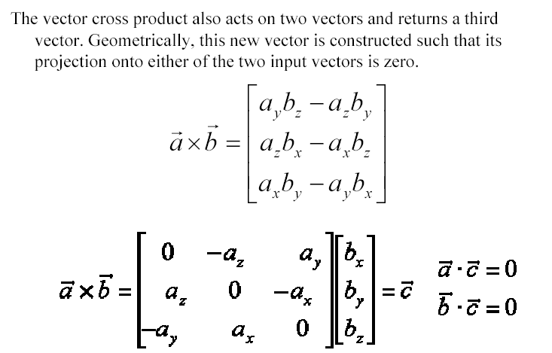
Review: Matrix Form of Cross Product

Slide 17
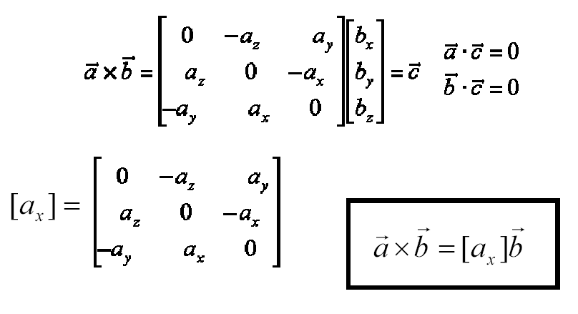
Review: Matrix Form of Cross Product

Slide 18
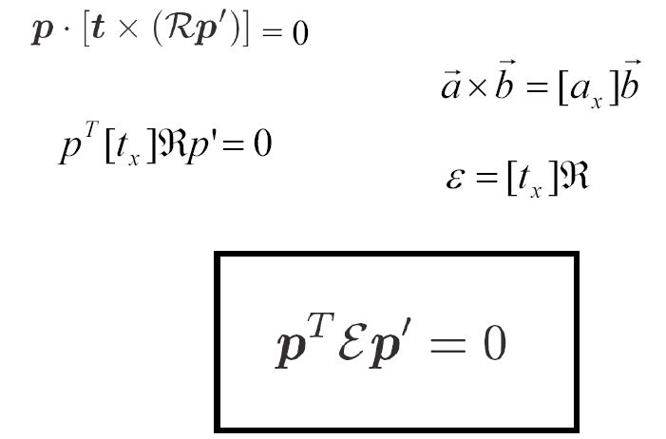
Matrix Form

Slide 19
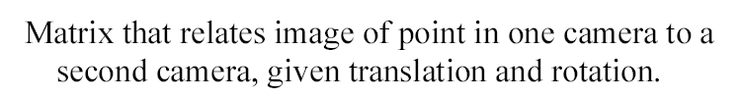
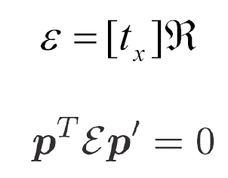
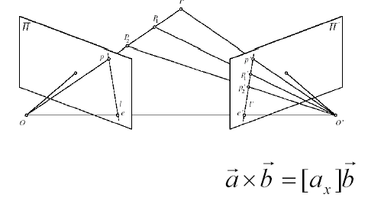
The Essential Matrix

Slide 20
The Essential Matrix
Based on the Relative Geometry of the Cameras
Assumes Cameras are calibrated (i.e., intrinsic parameters are known)
Relates image of point in one camera to a second camera (points in camera coordinate system).
Is defined up to scale
5 independent parameters

Slide 21
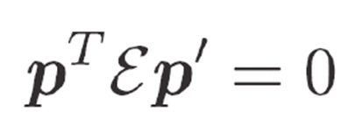
The Essential Matrix
What is εp’ ?

Slide 22
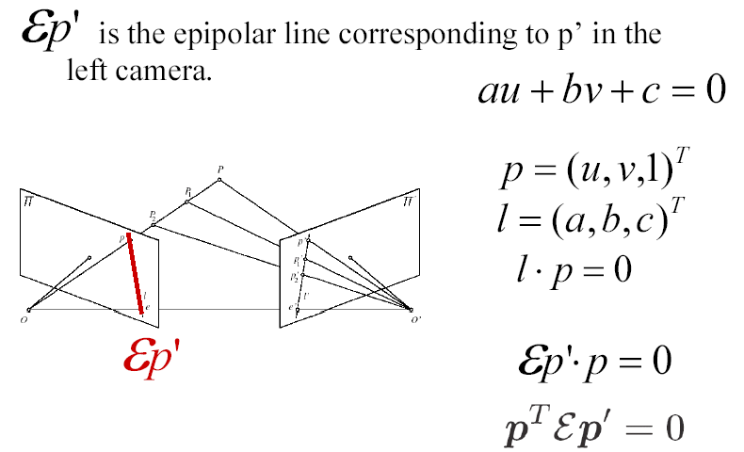
The Essential Matrix
p’
Similarly p is the epipolar line corresponding to p in the
right camera.

Slide 23
The Essential Matrix
e^{T}εe’ ?
What is εe’ ?
line εp’ converges to epipole e
e’ (center of camera C₂ expressed in frame C₁₎
εe’
e’

Slide 24
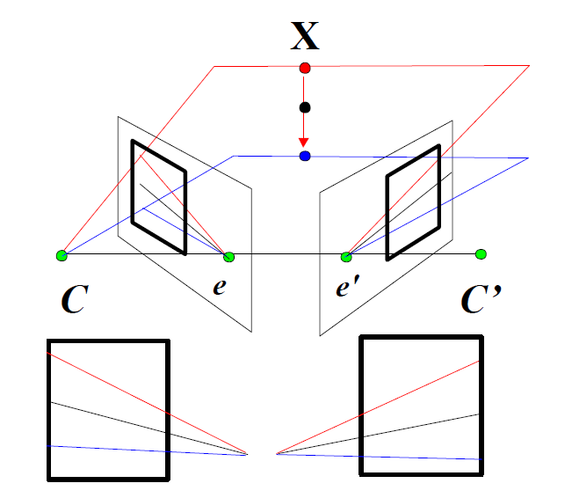
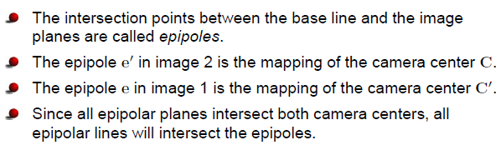
Pencil of epipolar lines

Slide 25
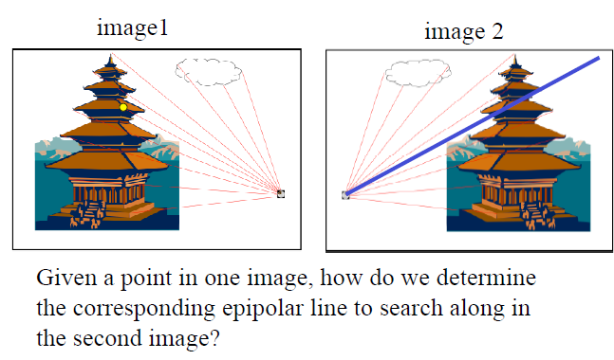
Pencil of epipolar lines
http://www.cse.psu.edu/~rcollins/CSE486/lecture19_6pp.pdf

Slide 26
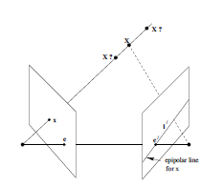
Epipoles
The epipolar line l’ = εx to each point x (except e) intersects the epipole e₀. Thus e’ satisfies e’^{T}(εx) = (e’^{T} ε)x = 0 for all x.
This implies that e’^{T} ε = 0^{T} or ε^{T}e’ = 0. The epipole e’ is thus a null vector to ε^{T} (in the left null-space of ε).
Similarly, εe = 0, i.e. e is a null-vector to ε (in the right null-space of ε).
MVG Hartley & Zisserman

Slide 27
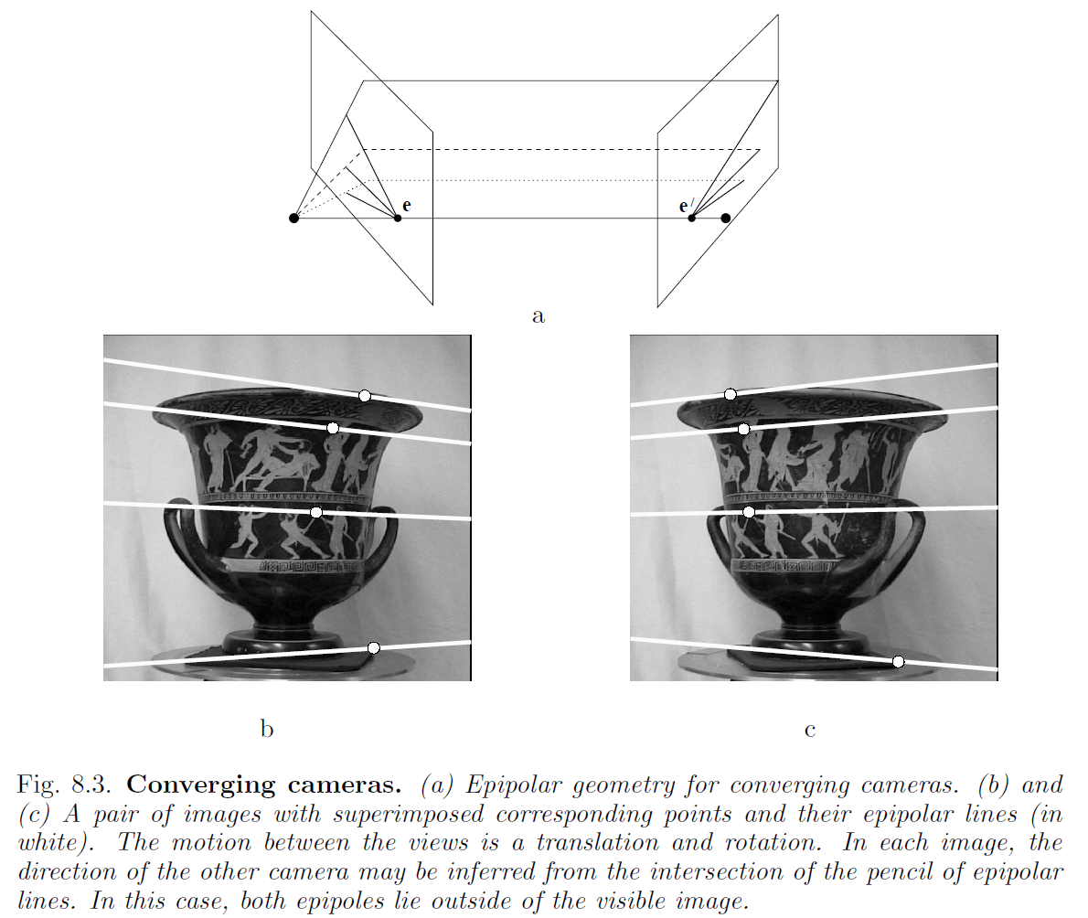
MVG Hartley & Zisserman

Slide 28
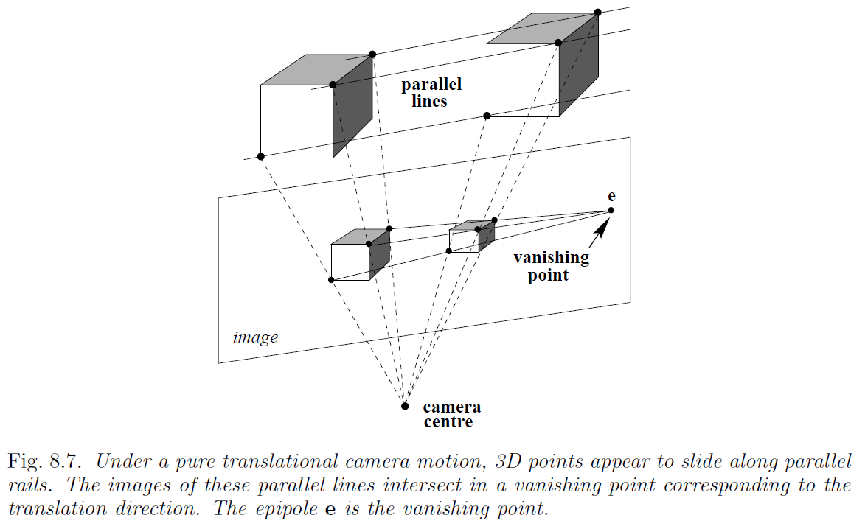
Epipoles
MVG Hartley & Zisserman

Slide 29
The Essential Matrix
Similarly,
The essential matrix ε = [t]×R has 5 degrees of freedom; 3 rotation angles in R, 3 elements in t, but arbitrary scale.
Essential Matrix is singular with rank 2.

Slide 30
What if Camera Calibration is not known

Slide 31
Review: Intrinsic Camera Parameters
Y
M
Image plane
v
Z
C
X
u
m
Focal plane
Қ

Slide 32
Fundamental Matrix
If u and u’ are corresponding image coordinates then we have:

Slide 33
Fundamental Matrix
Fundamental Matrix is singular with rank 2.
The fundamental matrix F has 7 degrees of freedom: A 3 × 3 homogenous matrix has 8 degrees of freedom. The constraint rank(F) = 2 or det(F) = 0 reduces the number to 7.
In principal F has 7 parameters up to scale and can be estimated from 7 point correspondences.
Direct Simpler Method requires 8 correspondences
(Olivier Faugeras, Computer Vision textbook).

Slide 34
Estimating Fundamental Matrix
The 8-point algorithm (Faugeras)
Each point correspondence can be expressed as a linear equation:

Slide 35
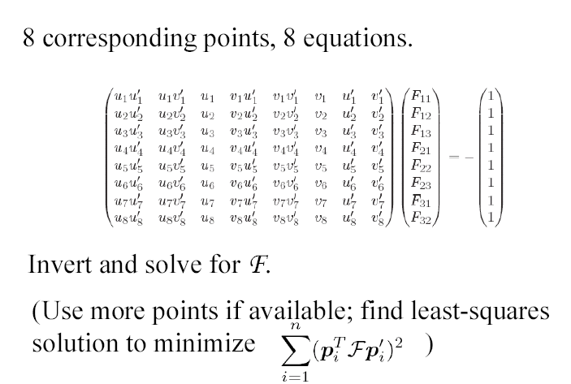
The 8-point Algorithm
Scaling: Set F₃₃ to 1 -> Solve for 8 parameters.

Slide 36
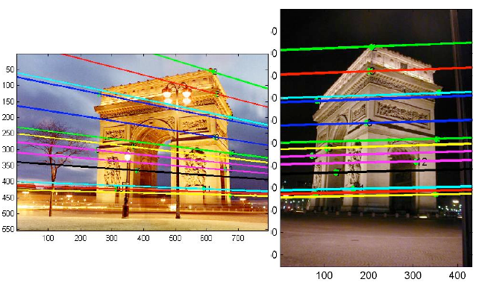
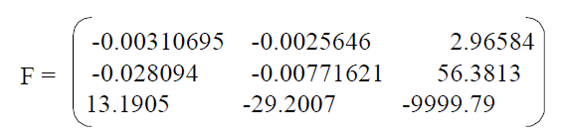
Example
http://www.cse.psu.edu/~rcollins/CSE486/lecture19_6pp.pdf

Slide 37
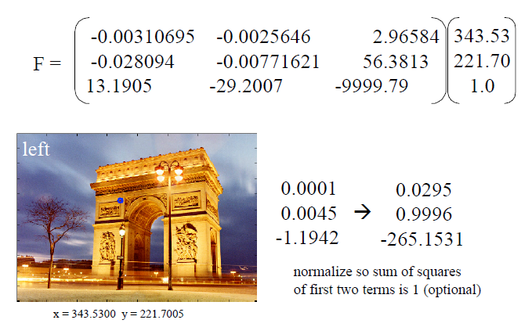
Example ctd.
u^{T}Fu’ = 0 → Fu’=l’, where l’ is epipolar line associated to u.
*
*refers to normal form of line:
rho = x cos(phi) + y sin(phi)
http://www.cse.psu.edu/~rcollins/CSE486/lecture19_6pp.pdf
Notes:
Why normalization: look at line equation: rho = xcos(phi)+ysin(phi) -> cos2 + sin2 = 1 -> normal form of line

Slide 38
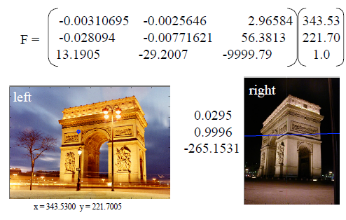
Example: Left to Right
http://www.cse.psu.edu/~rcollins/CSE486/lecture19_6pp.pdf

Slide 39
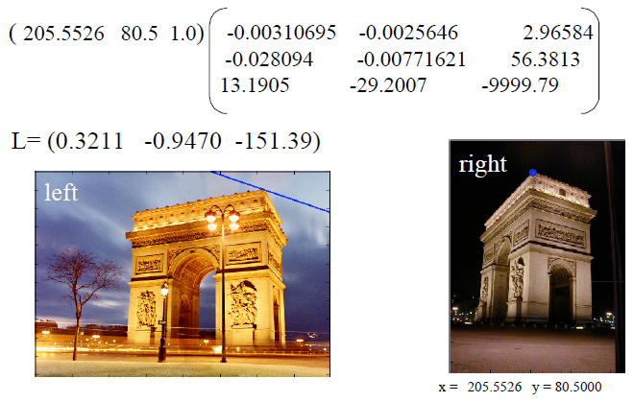
Example: Right to Left
http://www.cse.psu.edu/~rcollins/CSE486/lecture19_6pp.pdf

Slide 40
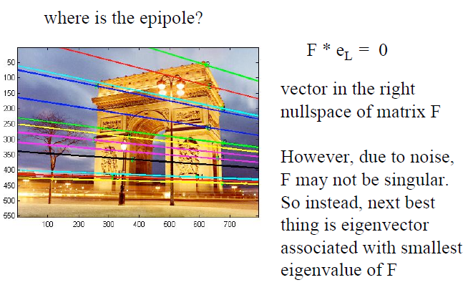
Example: Epipoles?
http://www.cse.psu.edu/~rcollins/CSE486/lecture19_6pp.pdf

Slide 41
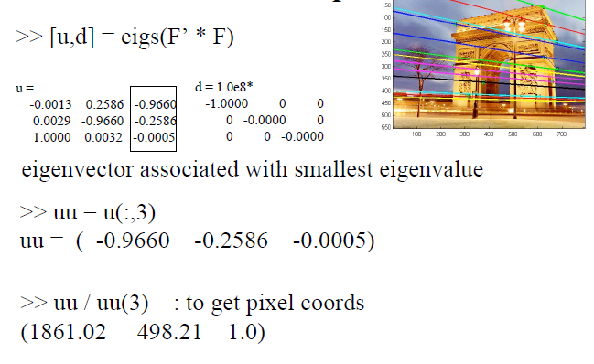
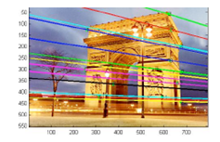
Example: Epipoles?
e
http://www.cse.psu.edu/~rcollins/CSE486/lecture19_6pp.pdf

